Slide 1
PHARMACOKINETICS EXCRETION

Slide 2
Introduction
One of the key PK aspect
Importance:
Essential for drug elimination. Ensures removal and termination of pharmacological effect.
Maintains therapeutic window & prevents accumulation → reduces risk of toxicity.

Slide 3
DRUG EXCRETION
Drugs are eliminated either in unchanged form or in the form of metabolites.
Water soluble compounds (eg. Atenolol, Gentamicin sulfate) are excreted easily than lipid soluble compounds.
Lipid soluble drugs are eliminated only after metabolised into polar or water soluble compounds.

Slide 4
Routes of drug excretion
Major routes:
Renal
Biliary
Faecal
Alveolar
Minor routes:
Milk
Skin
Hair
Sweat
Saliva

Slide 5
Renal route
Accounts for 25–30% of drug excretion
Excretion of free (unbound) drugs & water-soluble metabolites.
Furosemide
Gentamicin
d-Tubocurarine
Digoxin

Slide 6
Renal Excretion
Glomerular Filtration
Tubular Secretion
Affected by urinary pH, PPB, nephron function
Influenced by molecular size, charge & PPB
Depends on membrane transporters, PPB
Tubular Reabsorption
Passive, non-saturable. Driven by hydrostatic pressure.
Active, carrier mediated, saturable.
Passive (lipophilic unionised drugs) or active (glucose, amino acids)

Slide 7
Factors Affecting Renal Excretion:
Molecular size
Plasma protein binding (PPB) – only unbound drug is excreted.
Renal blood flow
Activity of SLC family transporters (e.g., OAT1, OCT2)
Urinary pH: Acidic urine → basic drugs are ionized → ↓ reabsorption → ↑ excretion
Urine alkalinization used to enhance excretion in basic drug poisoning (e.g., amphetamines)

Slide 8
Biliary & Faecal route
Drug or metabolite conjugated in the liver → secreted into bile → enters GI tract
Two Possible Fates:
Deconjugated in intestine → Reabsorbed → Enterohepatic Circulation → prolongs half-life
Unabsorbed → Excreted via faeces
Examples:
Enterohepatic cycling: Morphine, Diazepam, Rifampicin
Faecal excretion (minimal absorption): Neomycin, Erythromycin

Slide 9
Pulmonary (Alveolar) Excretion
Excreted Substances:
Gases and volatile liquids - General anaesthetics
Alcohols
Dependent on partial pressure of drug in pulmonary blood.

Slide 10
Excretion through breast milk
Breast milk is slightly acidic (pH ~6.6) compared to plasma.
Weak bases (unionised in plasma) diffuse into milk → become ionised in acidic milk → trapped (ion trapping).
Weak acids ionise in plasma → limited transfer; if they enter milk, they may re-equilibrate back to plasma.
Result: Weak bases accumulate more in breast milk than weak acids.
Examples:
Chloramphenicol, Tetracyclines, Morphine, Diazepam

Slide 11
Excretion through minor routes
Skin: Griseofulvin is secreted through keratin precursor cells in skin.
Hair: Arsenic , Mercury salts, and Iodides. Mainly forensic significance.
Saliva: Iodine, Potassium iodide, Lithium and Phenytoin.
Sweat: Amines and Urea derivatives

Slide 12
Clearance
A measure of body’s efficiency in eliminating drug from systemic circulation.
Aim: To maintain steady state concentration of a drug within therapeutic range associated with therapeutic efficacy and minimum toxicity for the given agent.

Slide 13
In complete bioavailability steady state is achieved when rate of elimination equals rate of drug administration (dosing rate).
Dosing rate = CL x C_{ss}
Significance: Values of clearance and steady state concentration of drug in plasma are used while calculating dosing schedule for the patient.
Notes:
Loading dose depends on the Volume of Distribution; While Maintenance dose depends on Clearance

Slide 14
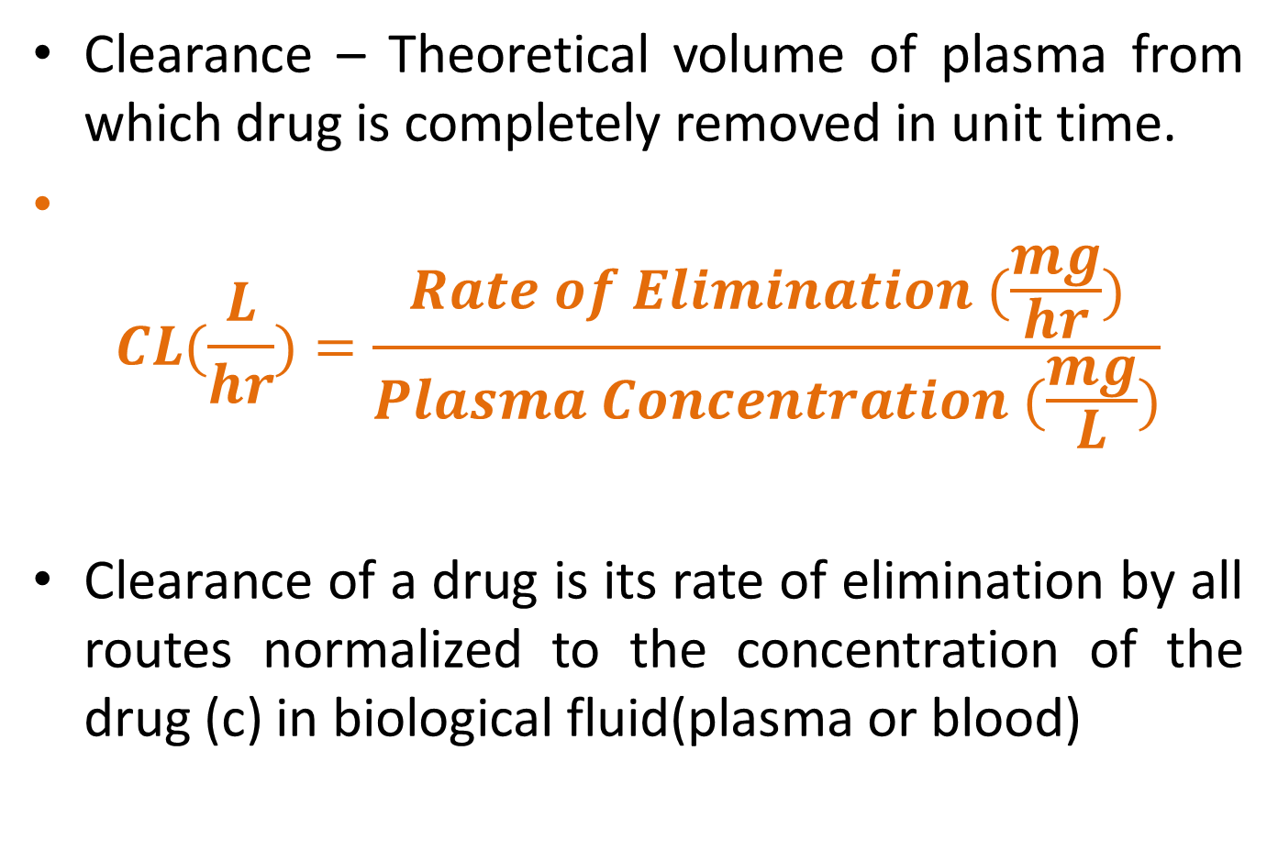
Clearance – Theoretical volume of plasma from which drug is completely removed in unit time.
$$CL(\frac{L}{hr})=\frac{Rate of Elimination (\frac{mg}{hr})}{Plasma Concentration (\frac{mg}{L})}$$
Clearance of a drug is its rate of elimination by all routes normalized to the concentration of the drug (c) in biological fluid(plasma or blood)

Slide 15
Clearance includes
Blood clearance (CL_{b})
Plasma clearance (CL_{p})
Clearance based on concentration of unbound drug(Cl_{u}).
Systemic clearance =
CL_{(renal)} + CL_{(hepatic)} + CL(Others: saliva, sweat, biliary, skin and hair)

Slide 16
Clearance with respect to individual organ:
The rate of presentation of drug to the organ is the product of blood flow (Q) and the arterial drug concentration (C_{A}).
And the rate of exit of drug from the organ is the product of blood flow and the venous concentration of the drug.

Slide 17
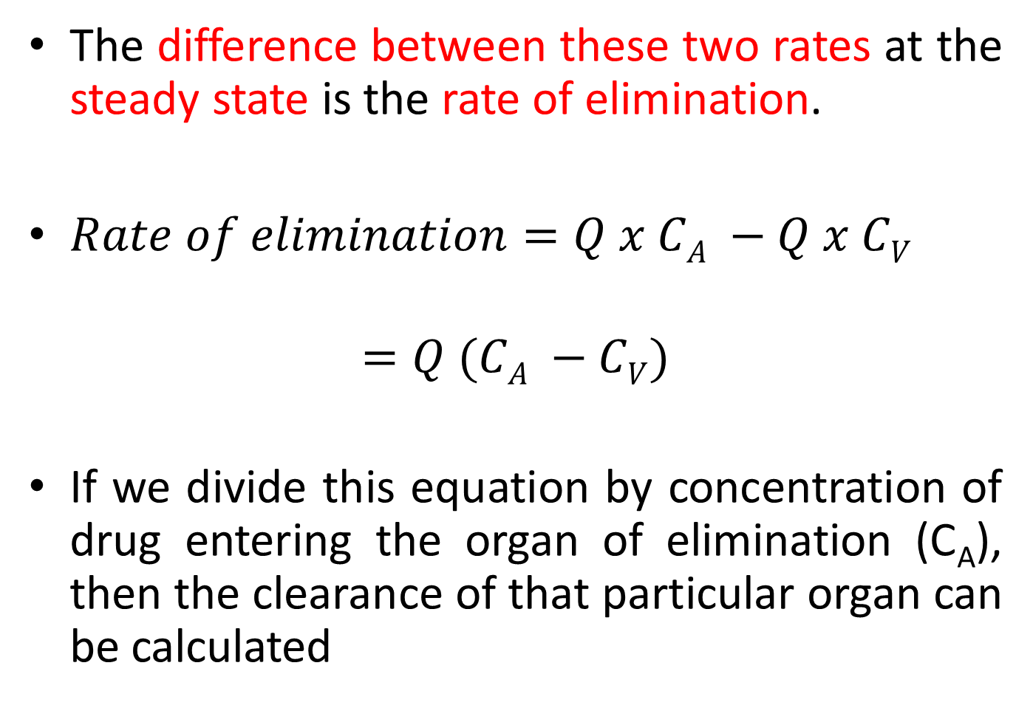
The difference between these two rates at the steady state is the rate of elimination.
$Rate of elimination=Q x CA −Q x CV$
$$=Q (CA −CV)$$
If we divide this equation by concentration of drug entering the organ of elimination (C_{A}), then the clearance of that particular organ can be calculated

Slide 18

$Cl\left(organ\right)=\frac{Q\left[CA −CV\right]}{CA}$
$Cl\left(organ\right)=Q x E$
$E = \frac{CA −CV}{CA}$ (Where E is Extraction Ratio)

Slide 19
HEPATIC CLEARANCE
Clearance of drug in the circulation by hepatic processes.
Eg:
Diltiazem
Imipramine
Lidocaine
Morphine
Propranalol

Slide 20
Mechanism of Hepatobiliary Excretion
Active transport into bile via the ATP Binding Cassette (ABC) Transporters.
P-glycoprotein
Breast Cancer Resistance Protein (BCRP)
Multidrug Resistance Associated Protein (MRP-2)
Drug properties favouring biliary excretion:
High molecular weight (> 300-500 Da)
Water soluble polar conjugates

Slide 21
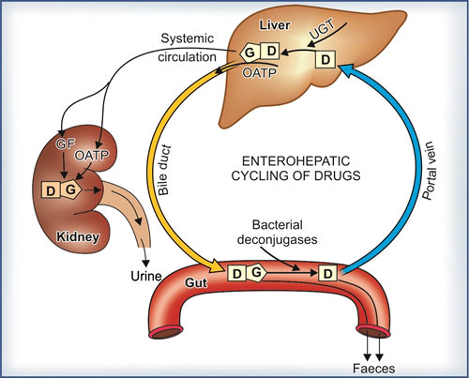
Enterohepatic Circulation
Liver excretes drug/metabolite into bile
Enters intestine
Prolongs systemic exposure
Deconjugated by gut flora
Reabsorbed into portal circulation
Results in multiple plasma peaks post dosing, extended t_{½}, potential reactivation of toxic metabolites.
Notes:
Like Irinotecan (SN-38)

Slide 22
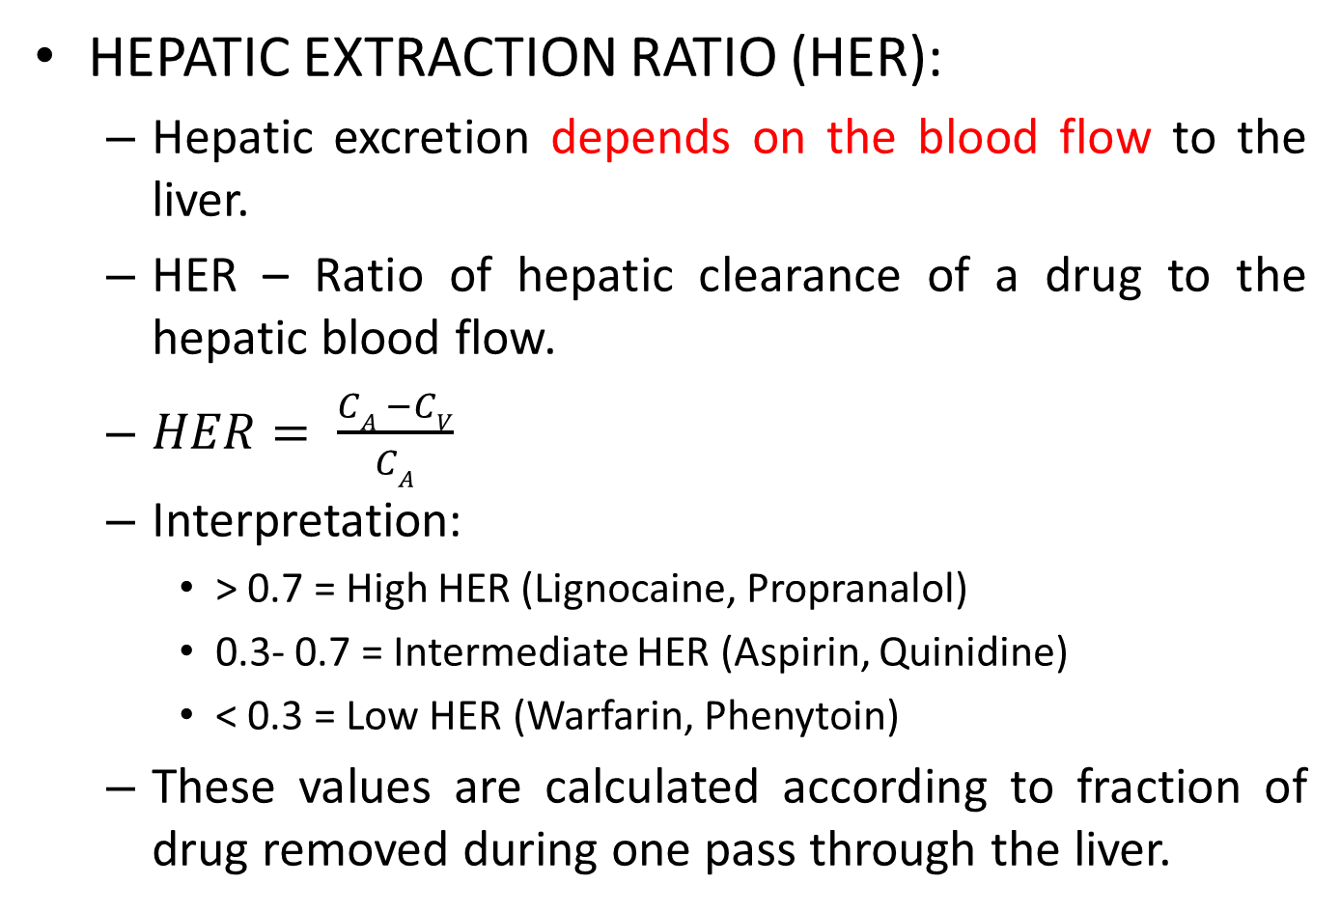
HEPATIC EXTRACTION RATIO (HER):
Hepatic excretion depends on the blood flow to the liver.
HER – Ratio of hepatic clearance of a drug to the hepatic blood flow.
$HER= \frac{CA −CV}{CA}$
Interpretation:
> 0.7 = High HER (Lignocaine, Propranalol)
0.3- 0.7 = Intermediate HER (Aspirin, Quinidine)
< 0.3 = Low HER (Warfarin, Phenytoin)
These values are calculated according to fraction of drug removed during one pass through the liver.

Slide 23
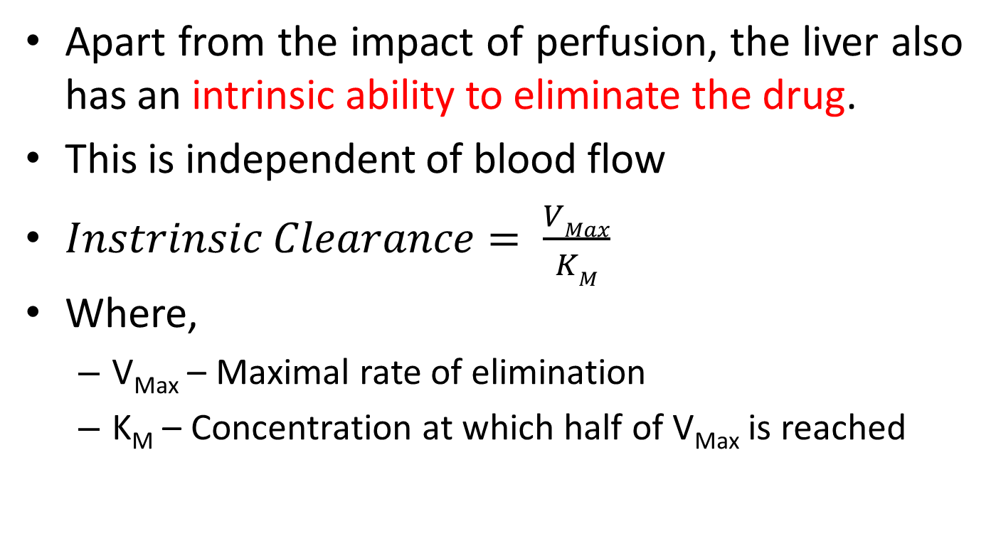
Apart from the impact of perfusion, the liver also has an intrinsic ability to eliminate the drug.
This is independent of blood flow
$Instrinsic Clearance= \frac{VMax}{KM}$
Where,
V_{Max} – Maximal rate of elimination
K_{M} – Concentration at which half of V_{Max} is reached

Slide 24
Any changes in the Hepatic Blood Flow → Clearance of drugs with high HER is limited.
Any changes in intrinsic clearance (in terms of enzyme induction or hepatic disease) → Clearance of drugs with low HER is affected.

Slide 25
Renal clearance:
Clearance of drugs in urine.
All three processes (GF, TS, TR) in nephron are needed for this clearance.

Slide 26
Kinetics of drug excretion
Following IV administration, repeated samples of blood taken.
The values of fall in the plasma concentration of the drug is noted.
These values are plotted in relation with time from which plasma half life is measured.

Slide 27
PLASMA HALF LIFE: (t_{½})
Time taken for plasma concentration to be reduced by 50%.
Duration in which plasma concentration of the drug falls by 50% of its earlier value
Biological effect half life: Time duration in which principal pharmacological effect of the drug declines by half
Rate and pattern of drug elimination follows either
FIRST ORDER or
ZERO ORDER kinetics.

Slide 28
FIRST ORDER KINETICS:
A constant fraction of drug is eliminated at a constant interval of time.
Eg: If plasma concentration of drug declining at a rate of 50% per 2 hrs:
t_{½} = 2hrs

Slide 29
In first order kinetics, the clearance remains constant over time.
Rate of elimination is directly proportional to plasma concentration , clearance remains constant.
If plasma concentration increases, rate of elimination also increases.

Slide 30
Fall in plasma concentration plotted against time, resultant graph is “plasma fall out curve”.
In Arithmetic Scale: Curvilinear
In Logarithmic Scale: Linear

Slide 31
t_{½} of any drug following first order kinetics remains constant irrespective of the dose.

Slide 32
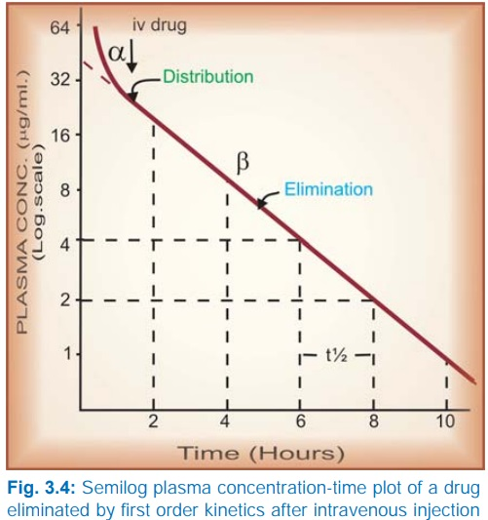

Slide 33
After a single dose, 97% of the drug gets excreted after 5 t_{½} intervals.
100 μg/mL
One t_{½}
50 μg/mL
Two t_{½}
25 μg/mL
Three t_{½}
12.5 μg/mL
Four t_{½}
6.125 μg/mL
Five t_{½}
3.25 μg/mL

Slide 34
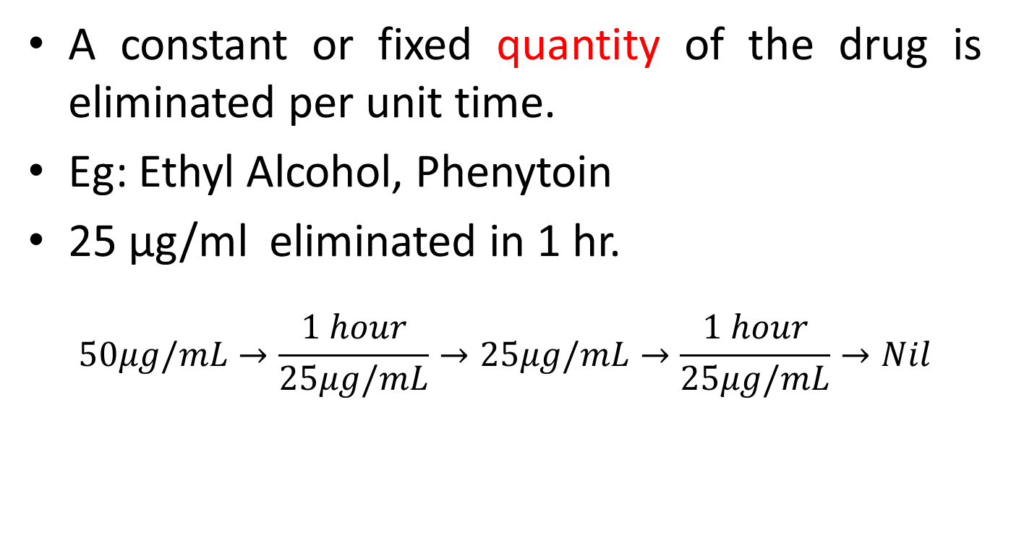
ZERO ORDER KINETICS :
A constant or fixed quantity of the drug is eliminated per unit time.
Eg: Ethyl Alcohol, Phenytoin
25 μg/ml eliminated in 1 hr.
$$50μg/mL→\frac{1 hour}{25μg/mL}→25μg/mL→\frac{1 hour}{25μg/mL}→Nil$$

Slide 35
Rate or amount of elimination independent of the concentration of the drug in plasma.
i.e. 25 μg/ml per hour is constant even if dose is increased; no proportional increase in extent of elimination.

Slide 36
t_{½} of a drug following zero order kinetics is never constant.
From 100 μg/mL to 50 μg/mL → t_{½} = 2 hrs
From 50 μg/mL to 25 μg/mL → t_{½} = 1 hr
100 μg/mL
75 μg/mL
50 μg/mL
25 μg/mL
Nil
$$\frac{1 hour}{25 μg/mL}$$
(1 ℎ𝑜𝑢𝑟)/(25 μg/mL)
$$\frac{1 hour}{25 μg/mL}$$
(1 ℎ𝑜𝑢𝑟)/(25 μg/mL)
$$\frac{1 hour}{25 μg/mL}$$
(1 ℎ𝑜𝑢𝑟)/(25 μg/mL)
$$\frac{1 hour}{25 μg/mL}$$
(1 ℎ𝑜𝑢𝑟)/(25 μg/mL)

Slide 37
If fall in plasma concentration is plotted against time:
Arithmetic scale : linear
Logarithmic scale: curvilinear

Slide 38
t_{½} of any drug following zero order kinetics changes along with a change in the dose.

Slide 39
MICHAELIS –MENTEN KINETICS :
Also known as mixed order or saturation kinetics.
Because metabolizing enzymes or elimination processes get saturated at higher concentration of drugs.
Smaller doses are handled by first order kinetics.
If plasma concentration reaches higher values, rate of drug elimination becomes zero order.

Slide 40
Plasma concentration increases disproportionately with increase in dosage.
Hence, also known as Dose dependent kinetics or capacity limited elimination
Eg.:
Phenytoin
Digoxin
Warfarin
Dicoumarol
Tolbutamide
Aspirin

Slide 41
Zero order kinetics curves at higher doses are:
Arithmetic scale:
Initially zero order: linear
Later first order : curvilinear
Logarithmic scale:
Initially zero order: curvilinear
Later first order: linear

Slide 42
For these drugs t_{½} changes with the dose.
Proper monitoring and maintenance of their plasma concentration needed.
Even small increase in dose above therapeutic range results in toxicity.

Slide 43
Clearance in impaired organ function
Impact of renal disease
Impact of hepatic disease
↓ GFR → ↓ glomerular filtration
↓ tubular secretion (↓ OAT/OCT function)
Altered reabsorption (e.g., in uremia or pH changes)
Result: ↓ renal clearance → ↑ half-life → drug accumulation
Adjust dose based on CrCl or eGFR
↓ CYP enzyme activity → ↓ metabolism (esp. Phase I)
↓ conjugation (e.g., glucuronidation, sulfation)
↓ biliary excretion (transporter dysfunction or cholestasis)
Result: ↓ hepatic clearance → ↑ drug exposure
Adjust dose based on Child-Pugh score; avoid high-extraction hepatotoxic drugs
Impaired conjugation (glucuronidation/sulfation) in severe cirrhosis or genetic defects.
Portosystemic shunting may bypass liver → altered first-pass metabolism.

Slide 44
Impact of impaired organ function on PK
Impact of renal disease
Impact of hepatic disease
↑ t_{½} and ↓ renal clearance.
Altered volume of distribution (Vd) due to fluid overload, hypoalbuminemia.
↑ free (unbound) drug due to decreased protein binding in uraemia.
↑ Bioavailability of high-extraction drugs (e.g., propranolol, verapamil).
↑ t_{½} due to impaired clearance.
↓ Protein binding due to hypoalbuminemia → ↑ free drug concentration.
Altered expression of hepatic transporters (e.g., OATP, BCRP).

Slide 45

Dose modification in renal disease
Calculate the creatinine clearance using the Cockroft-Gault formula:
$CrCL{(mL}/{min})= \frac{\left(140 −age\right) x weight \left(kg\right) x 0.85 (if female)}{72 x Serum Creatinine}$
Interpret the obtained CrCL
CrCl (mL/min) | Renal Function
>90 | Normal
60–89 | Mild impairment
30–59 | Moderate impairment
15–29 | Severe impairment
<15 | End-stage/kidney failure

Slide 46
Modify the dose
Lower the dose
Extend the dosing interval
Do both (especially for narrow therapeutic index drugs)

Slide 47
Dose modification in hepatic disease
Calculate the Child-Pugh score:
Based on 5 parameters: Bilirubin, Albumin, INR, Ascites, Encephalopathy.
Class (Score) | Degree of Hepatic Impairment | Recommendation
A (5 – 6) | Mild | Usually no dose adjustment needed
B (7 – 9) | Moderate | Consider dose reduction
C (10 – 15) | Severe | Use extreme caution or avoid

Slide 48
High-extraction drugs: Reduce Loading Dose.
Low-extraction drugs: Reduce Maintenance Dose.

Slide 49
In case of combined renal & hepatic impairment
Cumulative effects on metabolism and excretion.
Unpredictable PK behaviour → high interindividual variability.
Dose adjustments must consider both:
Renal excretion (CrCl)
Hepatic metabolism (Child-Pugh)
Use population PK models or TDM.
Often require greater dose reduction, longer intervals, and close monitoring.

Slide 50
Physiological & Pathological influences on Excretion
Age
Neonates – Immature hepatic/renal function → reduced clearance
Elderly - ↓GFR, ↓ hepatic blood flow → drug accumulation
Pregnancy
↑ GFR → enhanced renal clearance
Altered transporter activity and plasma protein levels.
Renal/Hepatic Impairment
↓ excretion → prolonged half life
↑ risk of toxicity from unmetabolized parent drug or active metabolites
Inhibitors or inducers of transporters (Probenecid inhibits OAT, Cimetidine inhibits OCT) → altered drug clearance
Drug-Drug Interactions
Critically ill
AKI or MODS – affects clearance
Use of TDM is essential.

